Slide 1

Kelompok 21:
Perry Tjahya 2406409965
Sutan Rendy Rizaldi 2406434626
Muhammad Dhiya'ulhaq 2406356782
Vincenzo Fabian Tisila 2406354215
Asisten Lab: Jesaya David (JD)

Slide 2
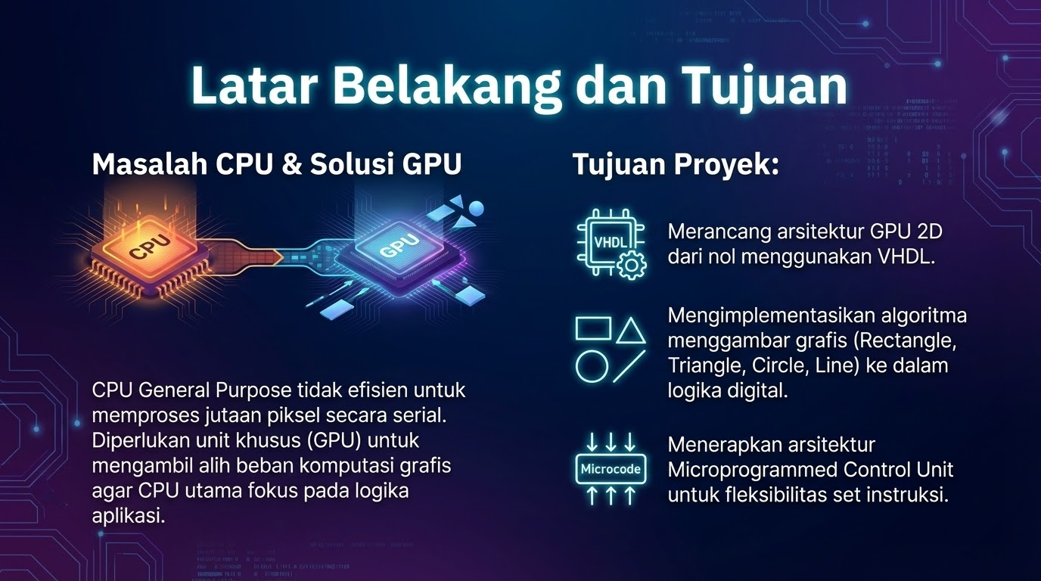

Slide 3
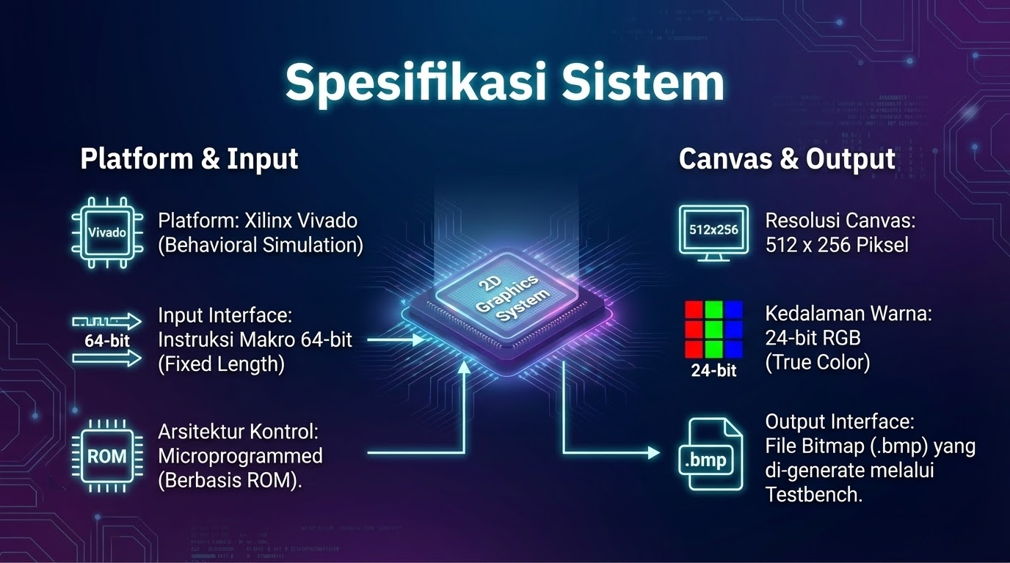

Slide 4
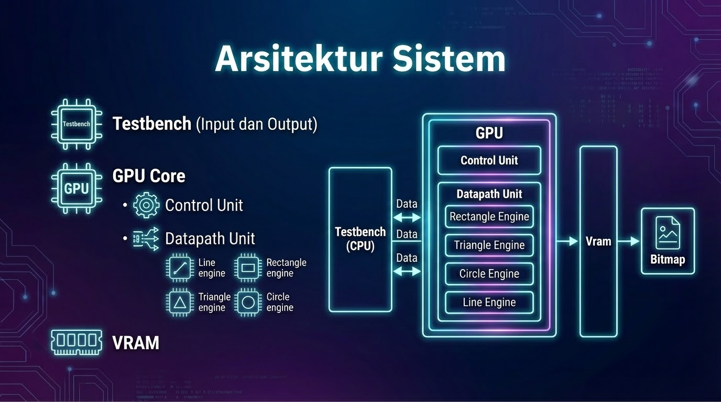

Slide 5
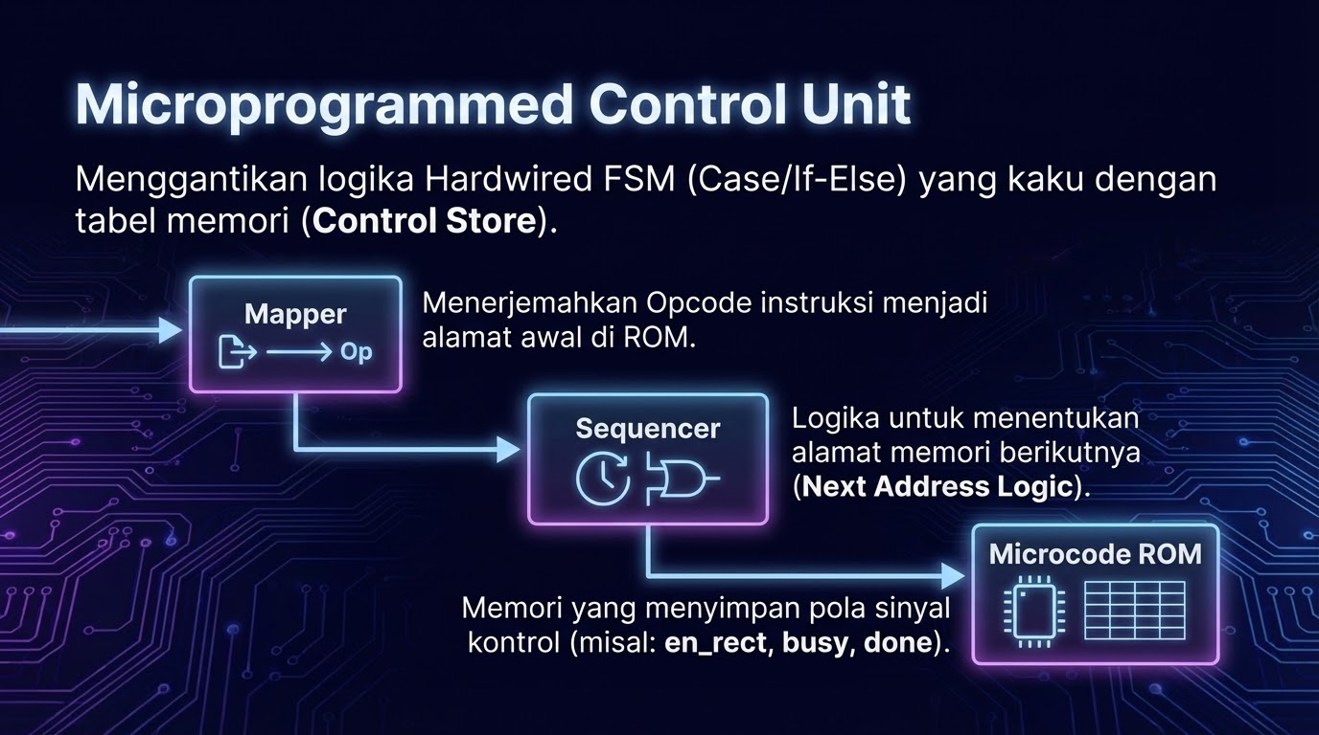

Slide 6
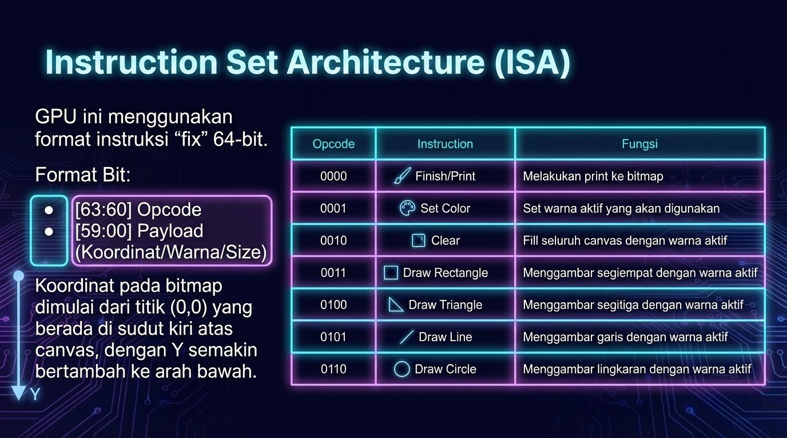

Slide 7
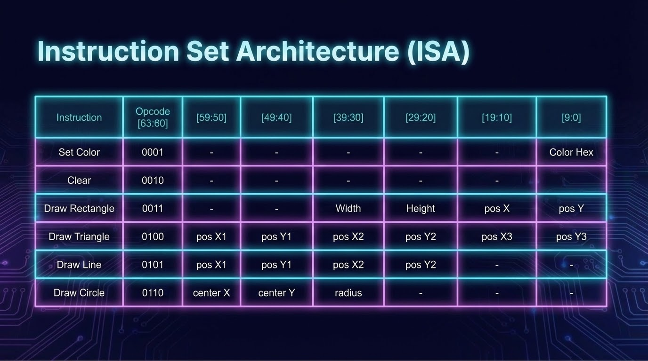

Slide 8
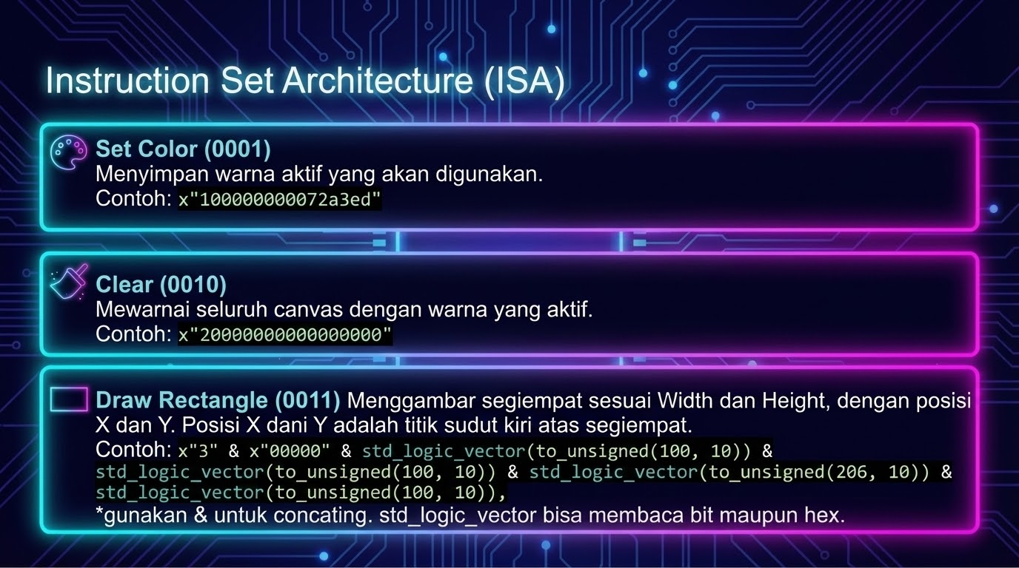

Slide 9
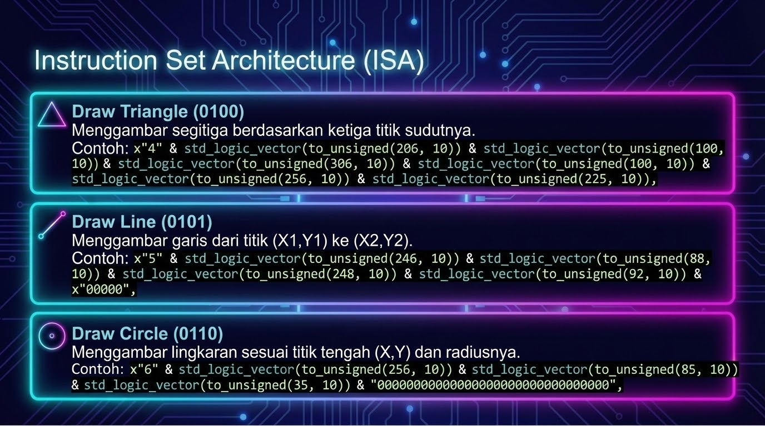

Slide 10
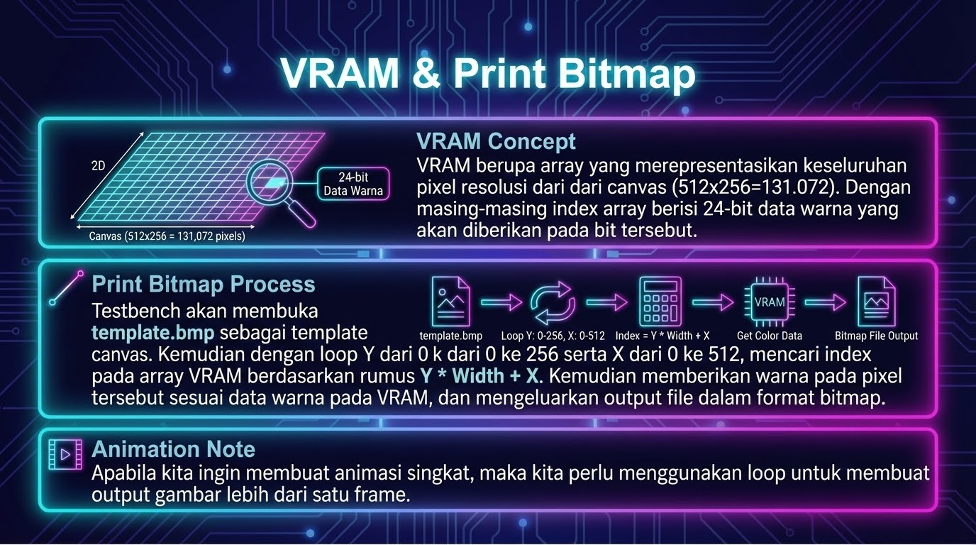

Slide 11



Slide 12
